Slide 1
The Data Link Layer
Chapter 3
  Data Link Layer Design Issues
  Error Detection and Correction
  Elementary Data Link Protocols
  Sliding Window Protocols
  Example Data Link Protocols
Revised: August 2011
CN5E by Tanenbaum & Wetherall, © Pearson Education-Prentice Hall and D. Wetherall, 2011
Notes:
Gray units can be optionally omitted without causing later gaps

Slide 2
The Data Link Layer
This study deals with the algorithms for achieving reliable, efficient communication between two adjacent machines at the data link layer.
CN5E by Tanenbaum & Wetherall, © Pearson Education-Prentice Hall and D. Wetherall, 2011
Notes:
By adjacent, we mean that the two machines are connected by a communication channel that acts conceptually like a wire (e.g., a coaxial cable, telephone line, or point-to-point wireless channel). The essential property of a channel that makes it ''wirelike'' is that the bits are delivered in exactly the same order in which they are sent.

Slide 3
The Data Link Layer
Providing a well-defined service interface to the network layer.
Dealing with transmission errors
Regulating the flow of data so that slow receivers are not swamped by fast senders.
Application
Transport
Network
Link
Physical
CN5E by Tanenbaum & Wetherall, © Pearson Education-Prentice Hall and D. Wetherall, 2011

Slide 4
Data Link Layer Design Issues
  Frames »
  Possible services »
  Framing methods »
  Error control »
  Flow control »
CN5E by Tanenbaum & Wetherall, © Pearson Education-Prentice Hall and D. Wetherall, 2011

Slide 5
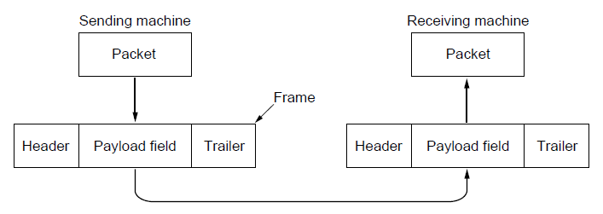
Network
Link
Virtual data path
Physical
Actual data path
CN5E by Tanenbaum & Wetherall, © Pearson Education-Prentice Hall and D. Wetherall, 2011

Slide 6
Frames
Link layer accepts packets from the network layer, and encapsulates them into frames that it sends using the physical layer; reception is the opposite process
Each frame contains a frame header, a payload field for holding the packet, and a frame trailer, as illustrated in Fig. 3-1.
Frame management forms the heart of what the data link layer does
Note
CN5E by Tanenbaum & Wetherall, © Pearson Education-Prentice Hall and D. Wetherall, 2011
Notes:
Although this chapter is explicitly about the data link layer and the data link protocols, many of the principles we will study here, such as error control and flow control, are found in transport and other protocols as well. In fact, in many networks, these functions are found only in the upper layers and not in the data link layer. However, no matter where they are found, the principles are pretty much the same, so it does not really matter where we study them. In the data link layer they often show up in their simplest and purest forms, making this a good place to examine them in detail.

Slide 7
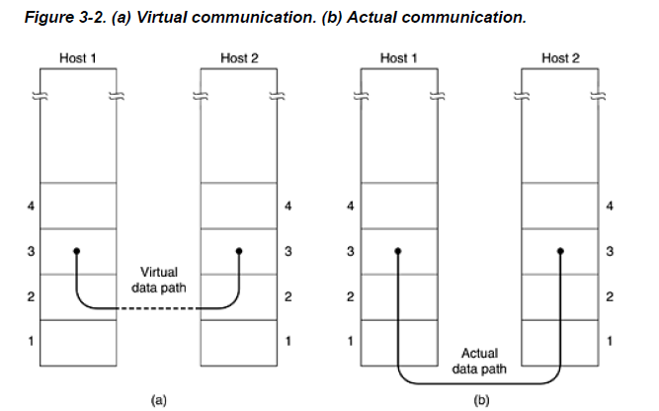
CN5E by Tanenbaum & Wetherall, © Pearson Education-Prentice Hall and D. Wetherall, 2011

Slide 8
The function of the data link layer is to provide services to the network layer(transferring data from the network layer on the source machine to the network layer on the destination machine)
Fig. 3-2(a). The actual transmission follows the path of Fig. 3-2(b), but it is easier to think in terms of two data link layer processes communicating using a data link protocol. For this reason, we will implicitly use the model of Fig. 3-2(a) throughout this chapter.
CN5E by Tanenbaum & Wetherall, © Pearson Education-Prentice Hall and D. Wetherall, 2011

Slide 9
Possible Services
Unacknowledged connectionless service
Acknowledged connectionless service
Acknowledged connection-oriented service
  Connection is set up; rare
CN5E by Tanenbaum & Wetherall, © Pearson Education-Prentice Hall and D. Wetherall, 2011

Slide 10
Unacknowledged connectionless service
  Frame is sent with no connection / error recovery
No logical connection is established beforehand or released afterward. If a frame is lost due to noise on the line, no attempt is made to detect the loss or recover from it in the data link layer.
This class of service is appropriate when the error rate is very low so that recovery is left to higher layers.
It is also appropriate for real-time traffic, such as voice, in whichlate data are worse than bad data. Most LANs use unacknowledged connectionless service in the data link layer.
  Ethernet is example
CN5E by Tanenbaum & Wetherall, © Pearson Education-Prentice Hall and D. Wetherall, 2011

Slide 11
Acknowledged connectionless service
When this service is offered, there are still no logical connections used, but each frame sent is individually acknowledged.
In this way, the sender knows whether a frame has arrived correctly. If it has not arrived within a specified time interval, it can be sent again.
This service is useful over unreliable channels, such as wireless systems.
  Example is 802.11
CN5E by Tanenbaum & Wetherall, © Pearson Education-Prentice Hall and D. Wetherall, 2011
Notes:
providing acknowledgements in the data link layer is just an optimization,
never a requirement. The network layer can always send a packet and wait for it to be acknowledged. If the
acknowledgement is not forthcoming before the timer expires, the sender can just send the entire message
again. The trouble with this strategy is that frames usually have a strict maximum length imposed by the
hardware and network layer packets do not. If the average packet is broken up into, say, 10 frames, and 20
139
percent of all frames are lost, it may take a very long time for the packet to get through. If individual frames are
acknowledged and retransmitted, entire packets get through much faster. On reliable channels, such as fiber,
the overhead of a heavyweight data link protocol may be unnecessary, but on wireless channels, with their
inherent unreliability, it is well worth the cost.

Slide 12
Acknowledged connection-oriented service
The source and destination machines establish a connection before any data are transferred.
Each frame sent over the connection is numbered, and the data link layer guarantees that each frame sent is indeed received.
Furthermore, it guarantees that each frame is received exactly once and that all frames are received in the right order.
CN5E by Tanenbaum & Wetherall, © Pearson Education-Prentice Hall and D. Wetherall, 2011

Slide 13
Acknowledged connection-oriented service
With connectionless service, in contrast, it is possible that a lost acknowledgement causes a packet to be sent several times and thus received several times. Connection-oriented service, in contrast, provides the network layer processes with the equivalent of a reliable bit stream.
CN5E by Tanenbaum & Wetherall, © Pearson Education-Prentice Hall and D. Wetherall, 2011

Slide 14
Framing
Note
CN5E by Tanenbaum & Wetherall, © Pearson Education-Prentice Hall and D. Wetherall, 2011
Notes:
To provide service to the network layer, the data link layer must use the service provided to it by the physical
layer. What the physical layer does is accept a raw bit stream and attempt to deliver it to the destination. This bit
stream is not guaranteed to be error free. The number of bits received may be less than, equal to, or more than
the number of bits transmitted, and they may have different values. It is up to the data link layer to detect and, if
necessary, correct errors.

Slide 15
Framing
Data link layer breaks the bit stream up into discrete frames and compute the checksum for each frame.
When a frame arrives at the destination, the checksum is recomputed.
If the newly-computed checksum is different from the one contained in the frame, the data link layer knows that an error has occurred and takes steps to deal with it (e.g., discarding the bad frame and possibly also sending back an error report).
CN5E by Tanenbaum & Wetherall, © Pearson Education-Prentice Hall and D. Wetherall, 2011

Slide 16
Framing Methods
Since it is too risky to count on timing to mark the start and end of each frame, other methods have been devised. In this section we will look at four methods:
1. Character count.
2. Flag bytes with byte stuffing.
3. Starting and ending flags, with bit stuffing.
4. Physical layer coding violations.
Note
CN5E by Tanenbaum & Wetherall, © Pearson Education-Prentice Hall and D. Wetherall, 2011
Notes:
Breaking the bit stream up into frames is more difficult than it at first appears. One way to achieve this framing is
to insert time gaps between frames, much like the spaces between words in ordinary text. However, networks
rarely make any guarantees about timing, so it is possible these gaps might be squeezed out or other gaps
might be inserted during transmission.

Slide 17
Framing – Byte count(Character count)
Character count uses a field in the header to specify the number of characters in the frame.
When the data link layer at the destination sees the character count, it knows how many characters follow and hence where the end of the frame is.
Simple, but difficult to resynchronize after an error
CN5E by Tanenbaum & Wetherall, © Pearson Education-Prentice Hall and D. Wetherall, 2011

Slide 18
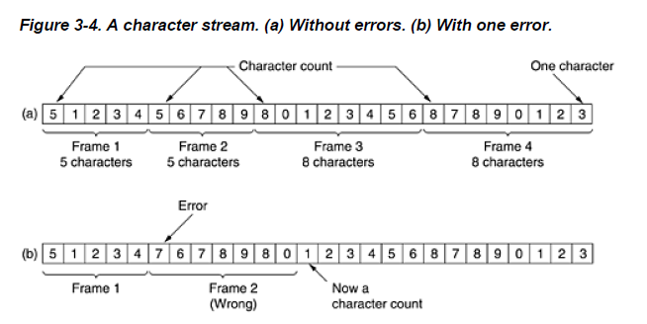
Framing – Byte count(Character count)
Note
CN5E by Tanenbaum & Wetherall, © Pearson Education-Prentice Hall and D. Wetherall, 2011
Notes:
The trouble with this algorithm is that the count can be corrupted by a transmission error.
For example, if the character count of 5 in the second frame of Fig. 3-4(b) becomes a 7, the destination will get out of
synchronization and will be unable to locate the start of the next frame.
Even if the checksum is incorrect so the
destination knows that the frame is bad, it still has no way of telling where the next frame starts.
Sending a frame back to the source asking for a retransmission does not help either, since the destination does not know how
many characters to skip over to get to the start of the retransmission.
For this reason, the character count method is rarely used anymore.

Slide 19
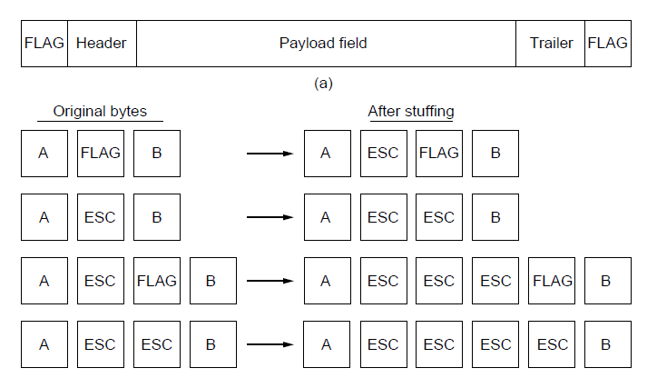
Framing – Byte stuffing
Special flag bytes delimit frames
occurrences of flags in the data must be stuffed (escaped)
Longer, but easy to resynchronize after error
Frame
format
Need to escape extra ESCAPE bytes too!
Stuffing
examples
CN5E by Tanenbaum & Wetherall, © Pearson Education-Prentice Hall and D. Wetherall, 2011

Slide 20
Framing – Byte stuffing
The byte-stuffing scheme depicted in Fig. 3-5 is a slight simplification of the one used in the PPP protocol that most home computers use to communicate with their Internet service provider.
A major disadvantage of using this framing method is that it is closely tied to the use of 8-bit characters.
CN5E by Tanenbaum & Wetherall, © Pearson Education-Prentice Hall and D. Wetherall, 2011
Notes:
Not all character codes use 8-bit characters. For example. UNICODE uses 16-bit characters,
As networks developed, the disadvantages of embedding the character code length in the framing mechanism became more and more obvious,
so a new technique had to be developed to allow arbitrary sized characters.

Slide 21
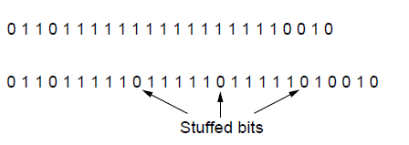
Framing – Bit stuffing
Stuffing done at the bit level:
  Frame flag has six consecutive 1s (not shown)
  On transmit, after five 1s in the data, a 0 is added
  On receive, a 0 after five 1s is deleted
Data bits
Transmitted bits
with stuffing
CN5E by Tanenbaum & Wetherall, © Pearson Education-Prentice Hall and D. Wetherall, 2011

Slide 22
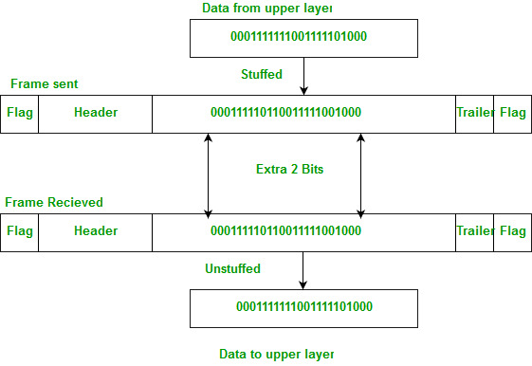
Framing – Bit stuffing
High-Level Data Link Control(HDLC) is a bit-oriented protocol.
CN5E by Tanenbaum & Wetherall, © Pearson Education-Prentice Hall and D. Wetherall, 2011

Slide 23
Framing- Physical layer coding violations
  only applicable to networks in which the encoding on the physical medium contains some redundancy
  Use non-data symbol to indicate frame
CN5E by Tanenbaum & Wetherall, © Pearson Education-Prentice Hall and D. Wetherall, 2011

